Slide 1
Laurea Raspberry Pi Projects
An overview, and Home Automation in detail

Slide 2
Overview

Slide 3
Overview
Router project (DHCP server)
Firewall Project (Intrusion Detection Prevention)
Services Project
  Home Automation (Pimatic + Pilight + Customizations)
  Wifi Access point (+DHCP server)
  OpenVPN server (Access local lan through VPN encryption)
  OwnCloud (Your very own cloud. Your equipment sets the limits)

Slide 4
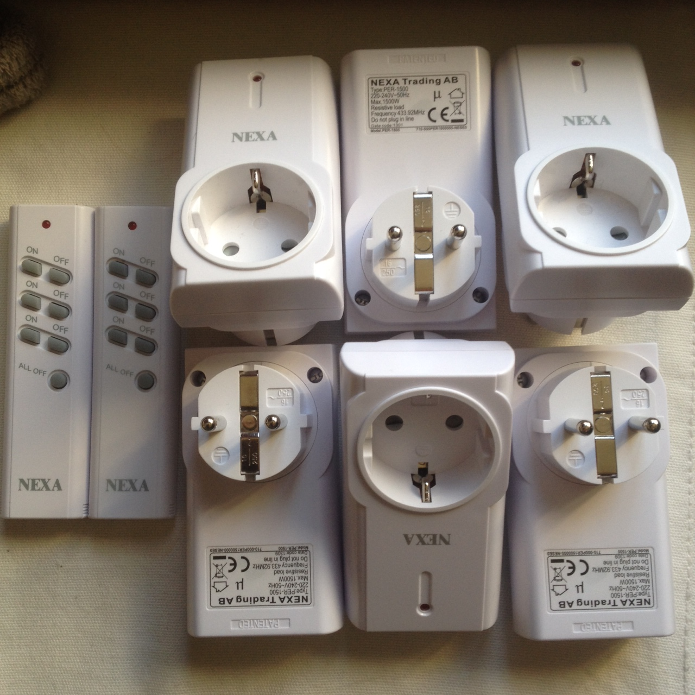
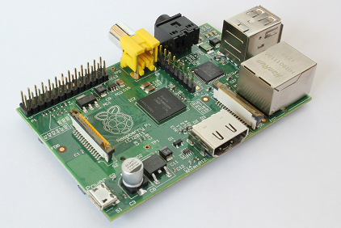
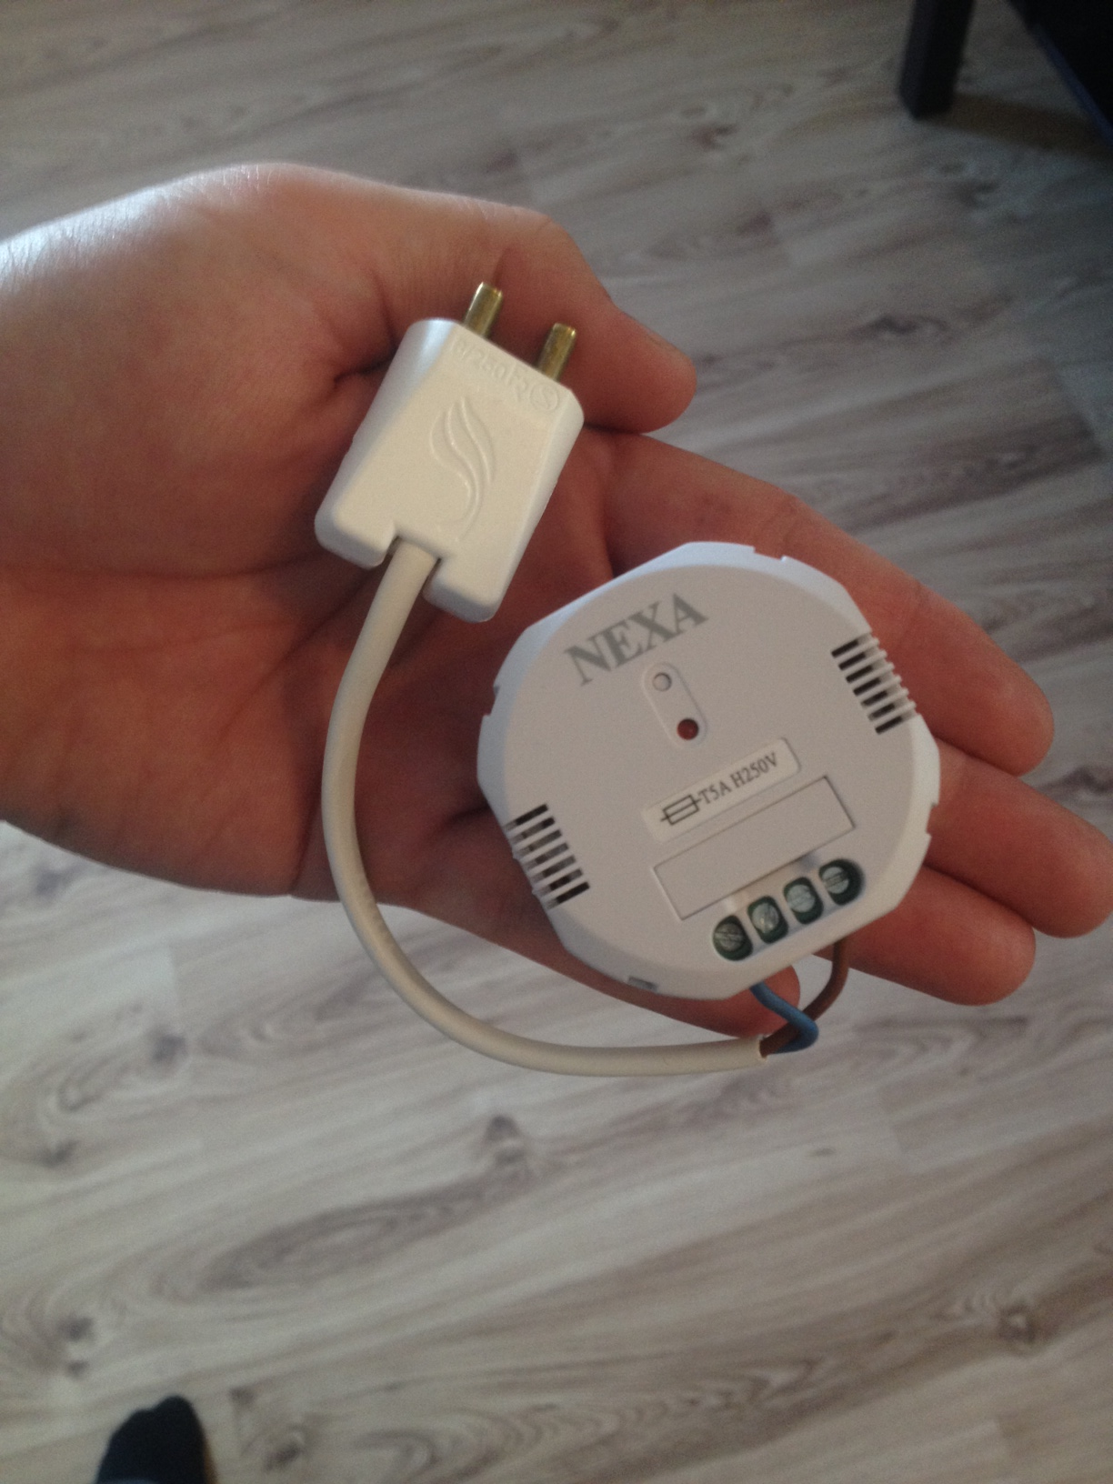
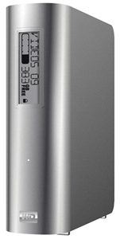

Components

Slide 5
Video
Questions?

Slide 6
Future possibilities (Services Project)
Temperature sensor
  Add a heater
Home Guard expansions
  Add a webcamera
Rules
  If this, then that. Endless possibilities.

